Slide 1

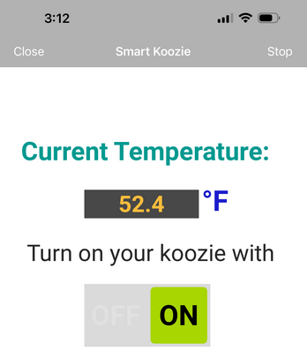
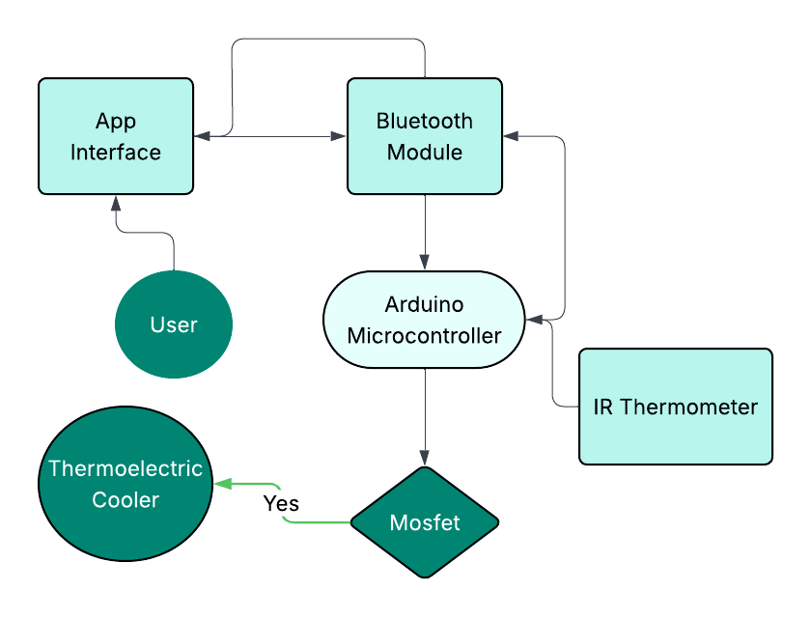
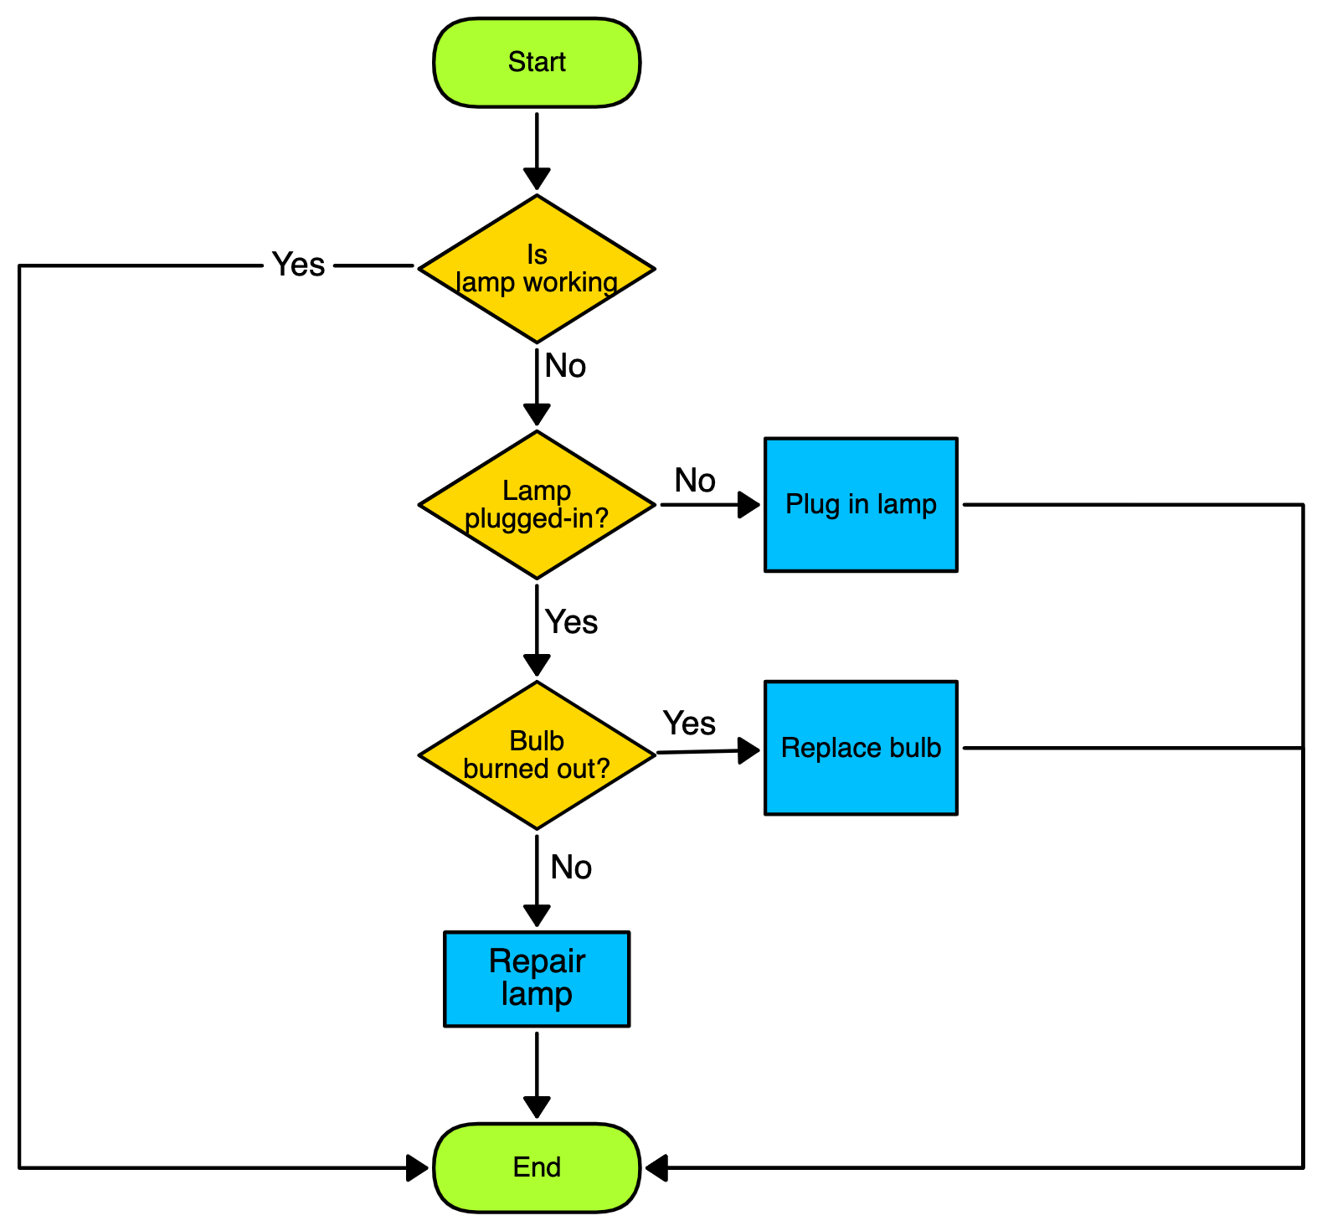
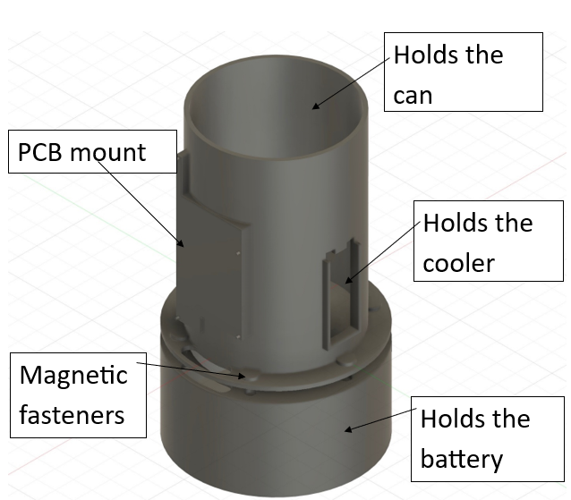
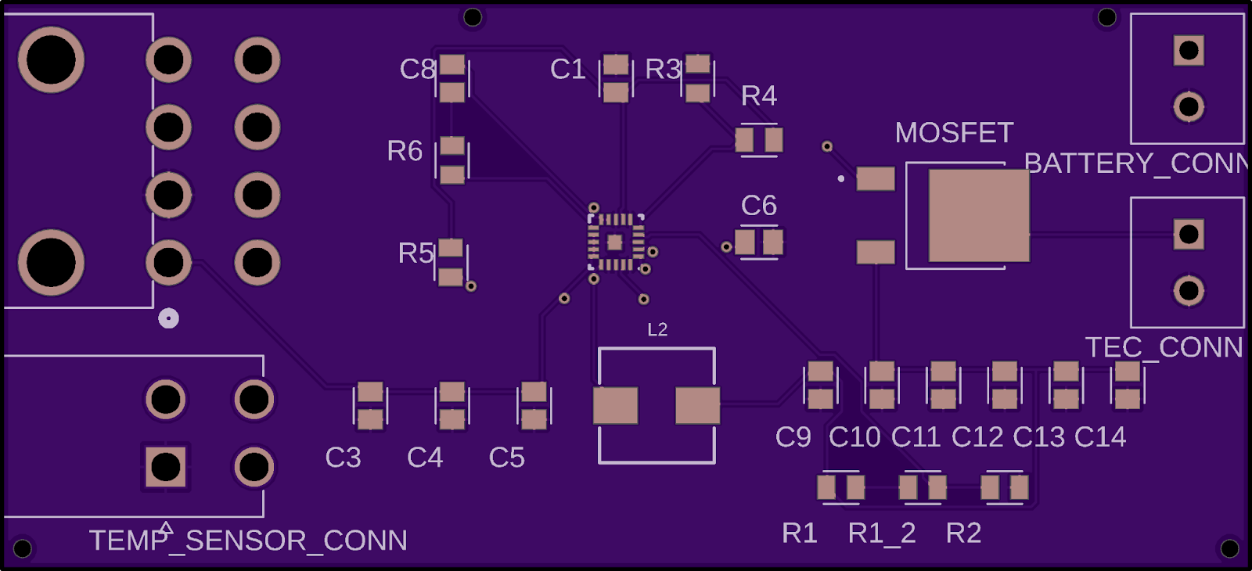
Smart Koozie Robert McKay, Juan Salas, Yohan Ksor Wofford College, South Carolina
Goal:
To regulate beverage temperatures to maintain a consistently cool temperature to ensure optimal refreshment, regardless of external conditions.
Problem:
Existing Solutions
Our Approach
Beverages rapidly lose their chill due:
Heat transfer from the surrounding air
Sunlight Exposure
The holder’s hand
Koozies (limited insulation)
Tumblers and Bottles (too bulky)
Ice Cubes (dilutes drink)
Refrigerator (not portable)
Mini Fridges (not portable)
Active cooling mechanism to maintain the beverage's cool temperature.
App integration to turn on or off the cooling feature
Portable design to have ease of cooling on the go.
Phone App Interface
System Overview
System Flow
Prototype Anatomy
Challenges
Prototype
Power step-down
Cooling management
Heat dissipation for micro components
App integration
Future Work
Adding adjustable temperature ability
Modifying/Creating an app User Interface
Improving product design

